Slide 1
Basics of Map Making

Slide 2
Map: spatial representation of the environment presented graphically
Representation: portrays the environment, a model
- Kimerling 2009

Slide 3


Why map things?
http://upload.wikimedia.org/wikipedia/commons/5/5f/Polynesian_navigation_device_showing_directions_of_winds%2C_waves_and_islands.jpg
http://en.wikipedia.org/wiki/File:Baylonianmaps.JPG
Notes:
-convenient to use
Simplify surroundings
Credible
Visual impact
Polynesian navigation device showing directions of winds, waves and islands

Slide 4
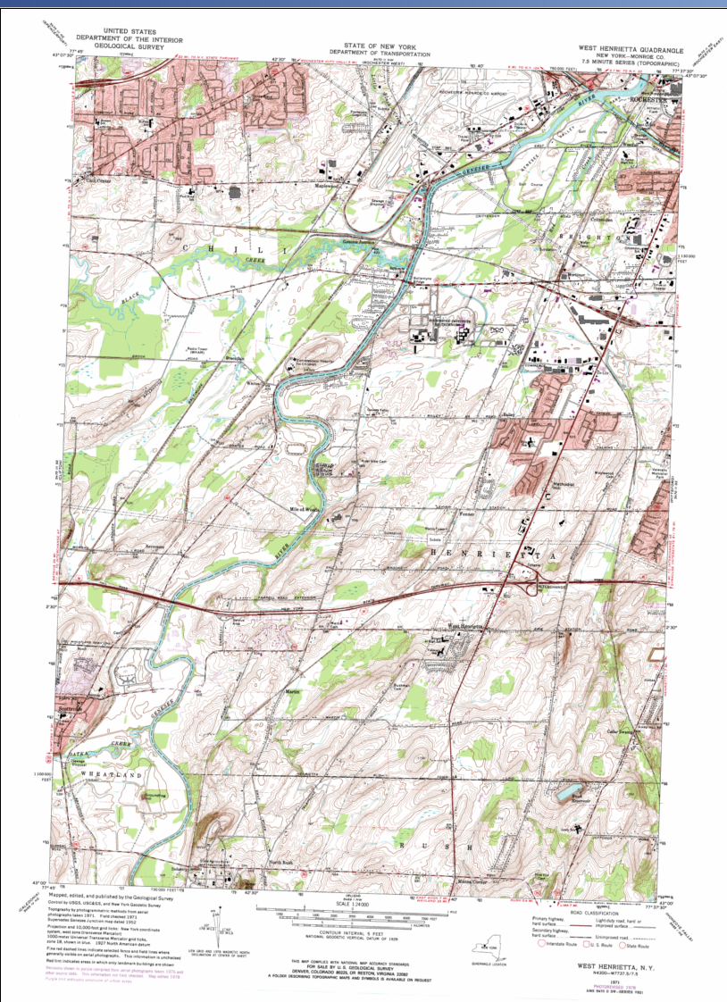
Reference Map
Numerous features
No specific information being shown

Slide 5
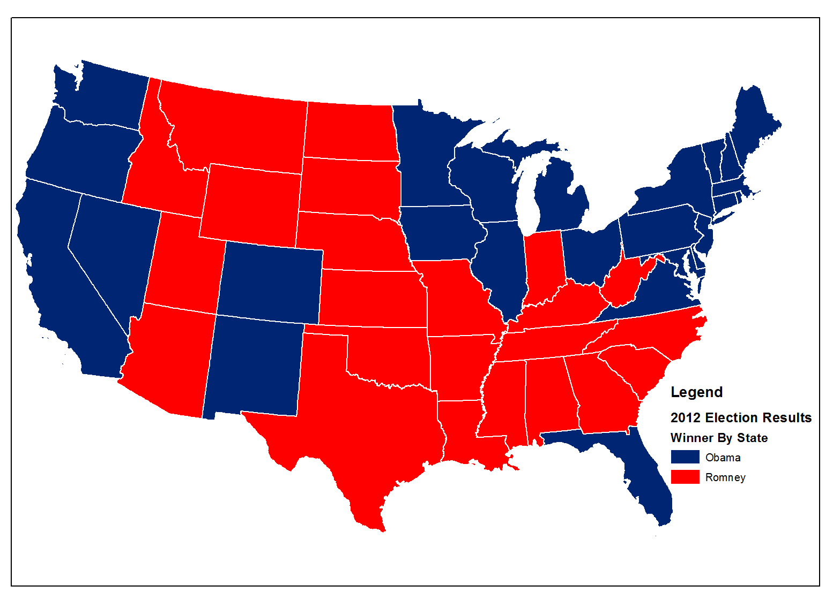
Thematic Map
Distributions of a single attribute
Relationships among several attributes
© 2013 B. Tomaszewski

Slide 6
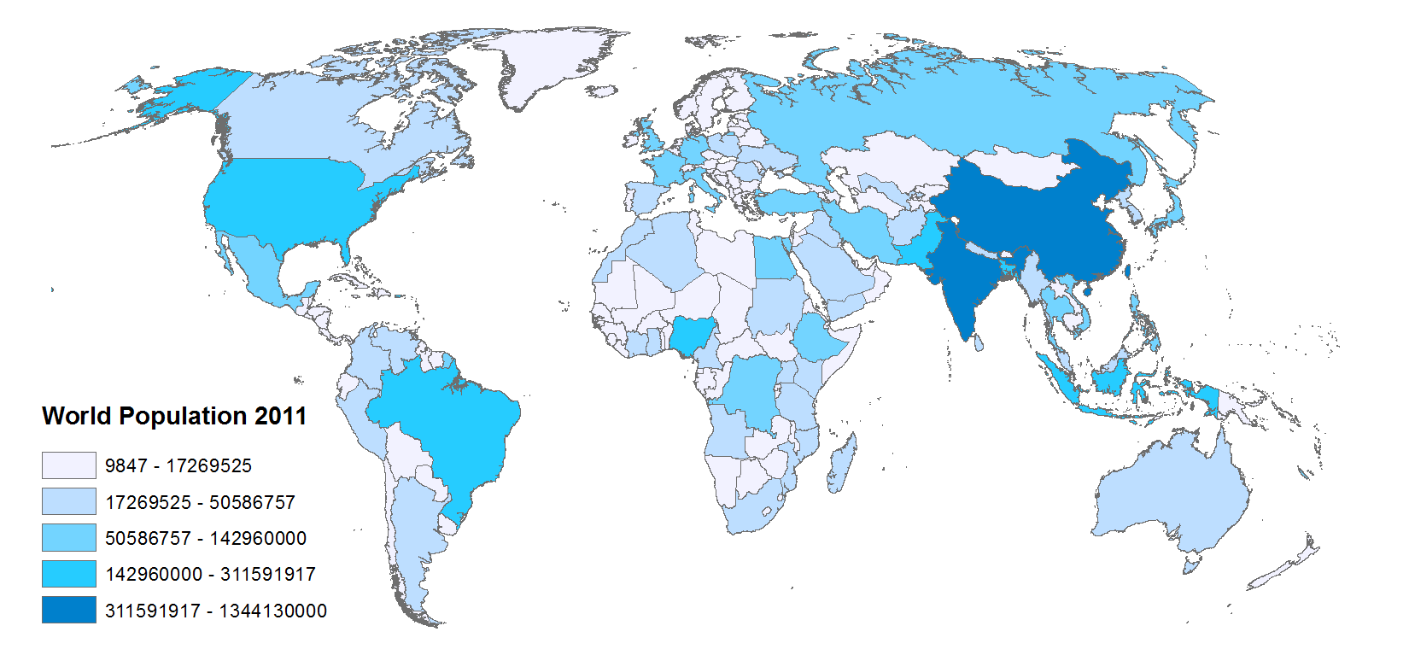
Choropleth Map
© 2013 B. Tomaszewski

Slide 7
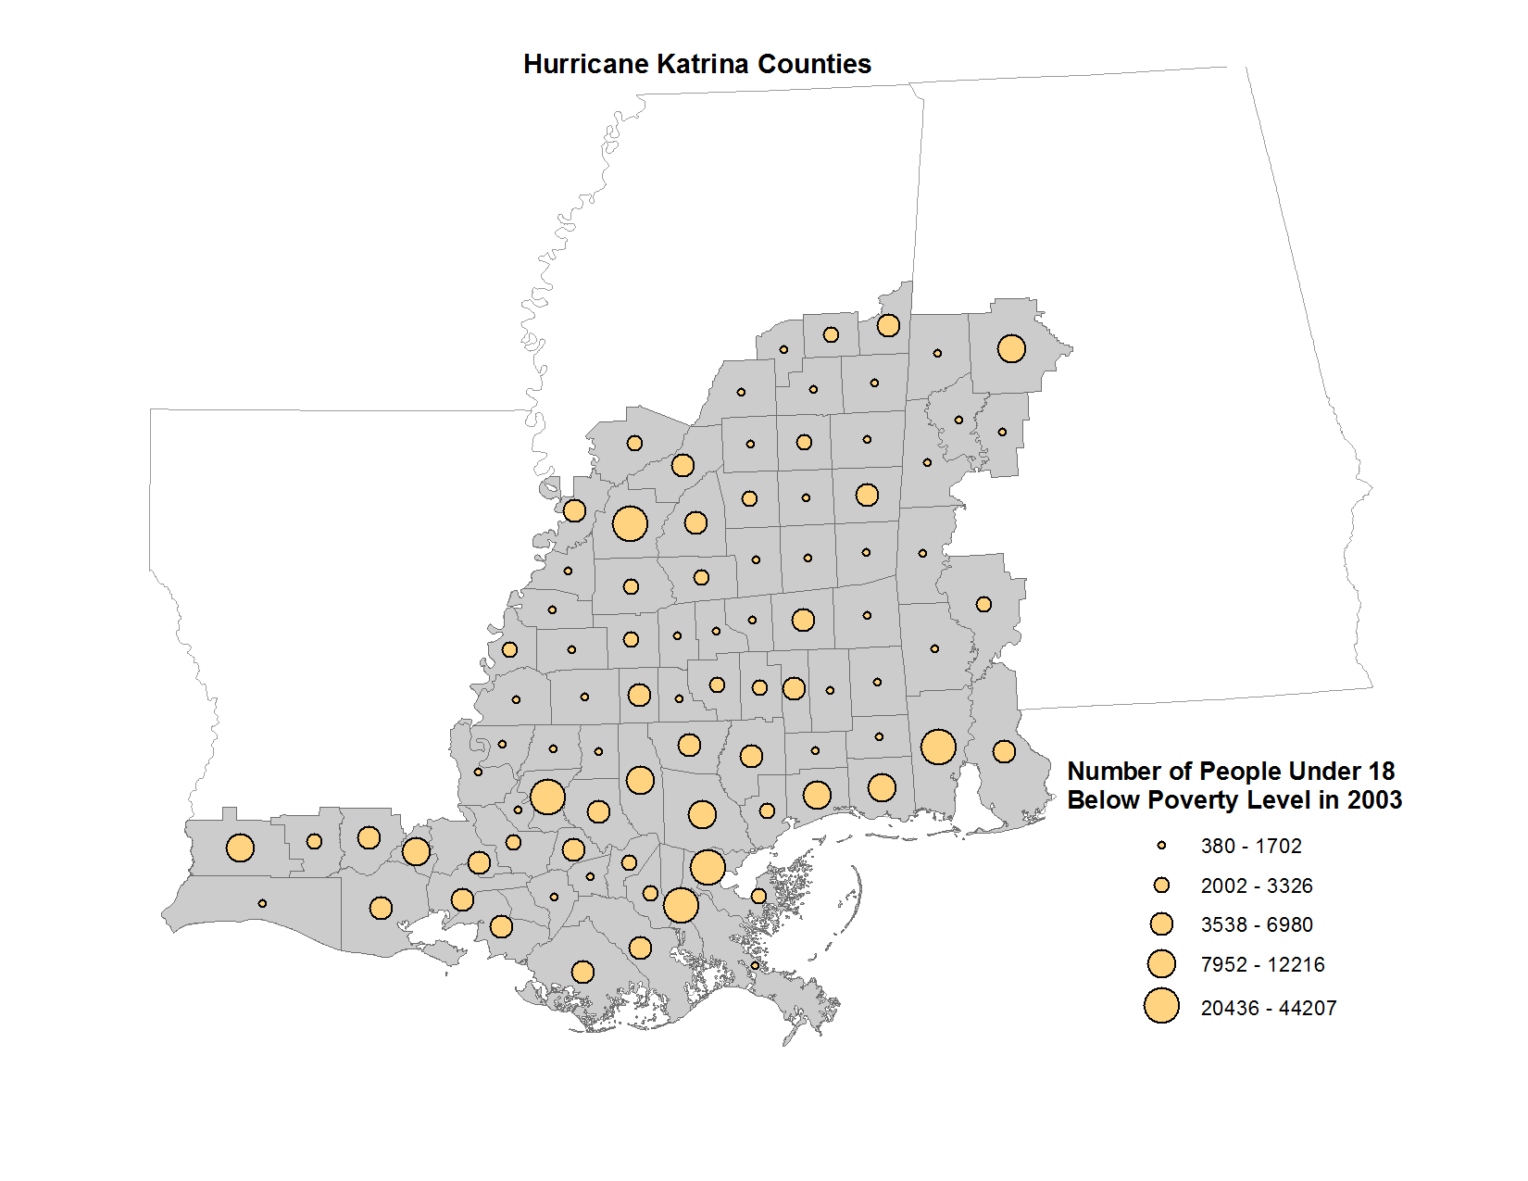
Proportional Symbol Map

Slide 8
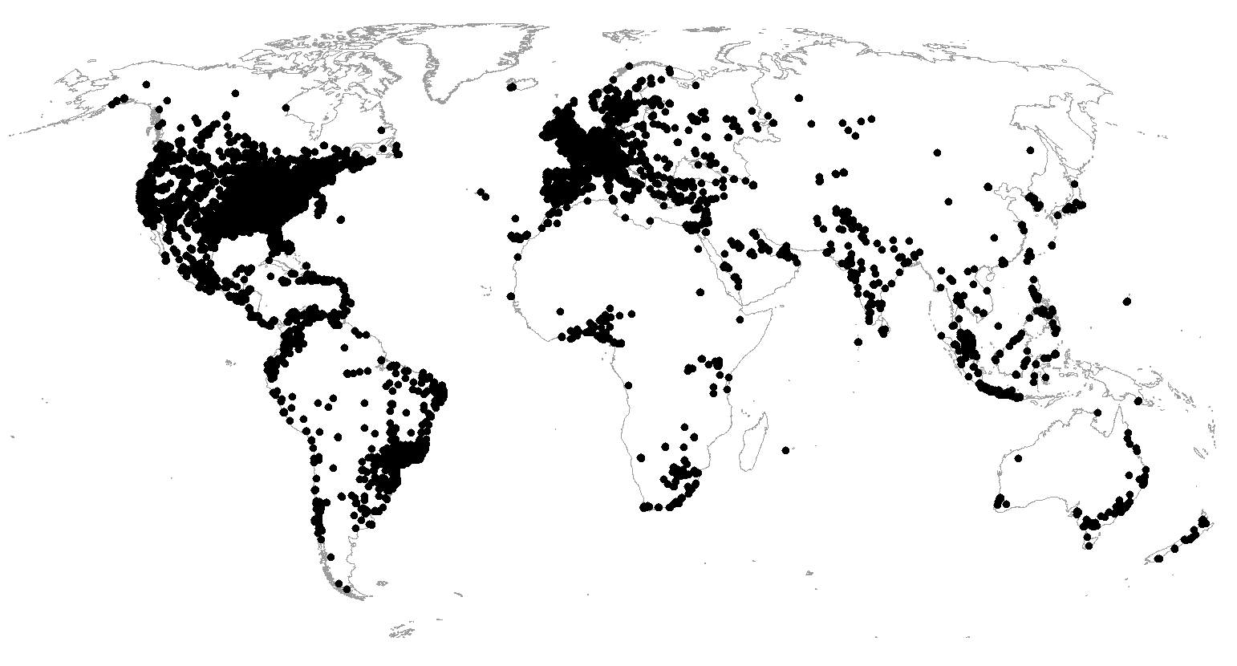
Dot Density Map
© 2013 B. Tomaszewski

Slide 9
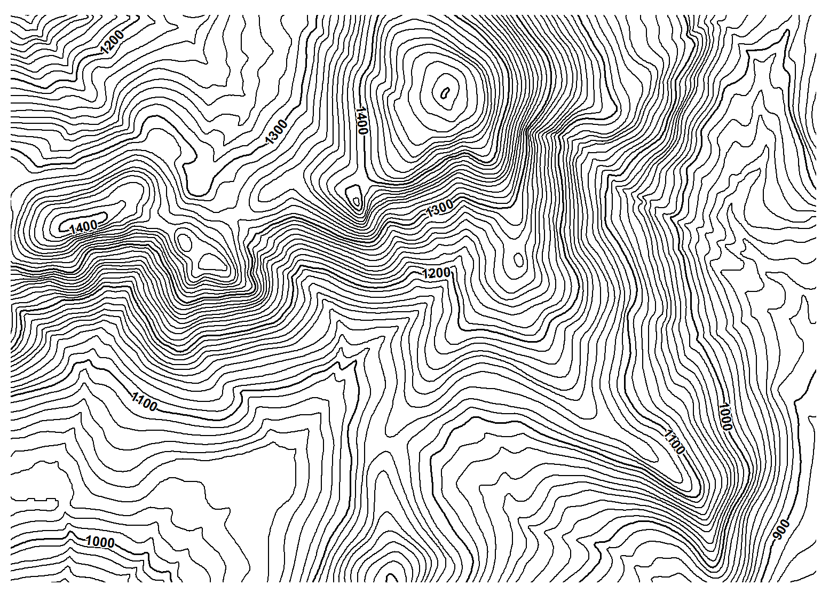
Isarithmic Map
© 2013 B. Tomaszewski

Slide 10
Thematic Map Hands On – ArcGIS Pro
Please do not do these steps until told to do so by the instructor (i.e. no skipping ahead)
Download Week 2 Hands On from My Courses
Open Themes.ppkx and you should get ArcGIS Pro open
Login in through enterprise login and type ritarcgis as your domain
Then use your sis login

Slide 11
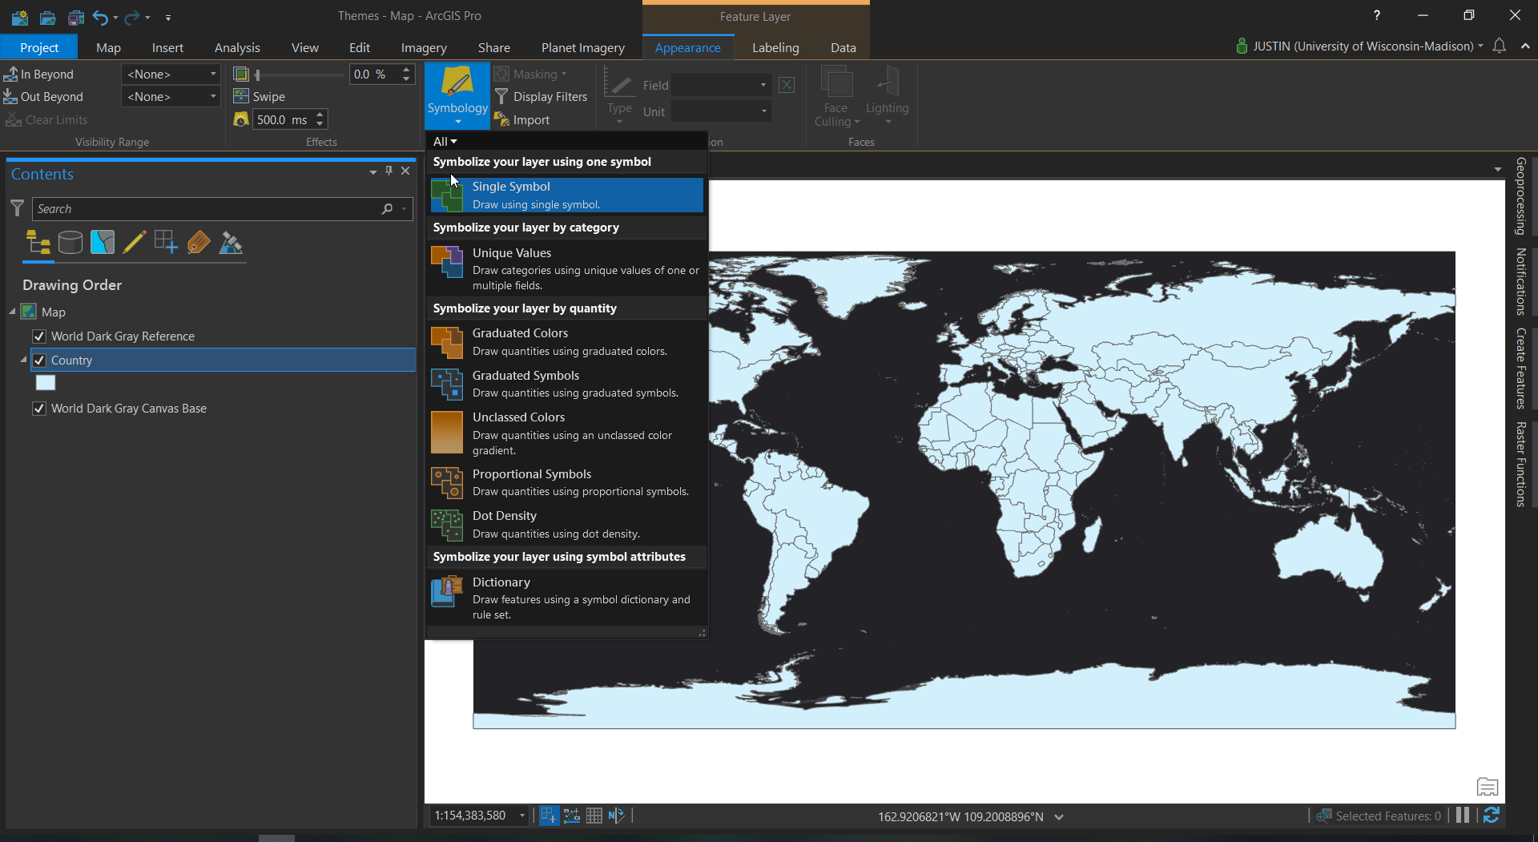
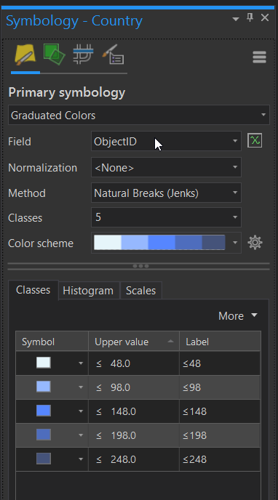
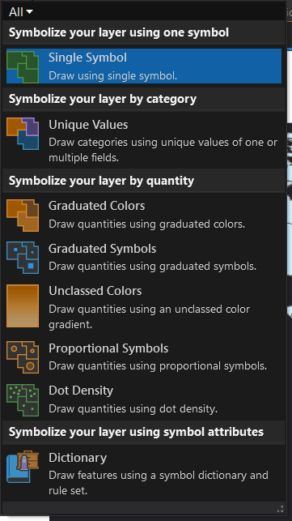
ArcGIS Pro Layout

Slide 12
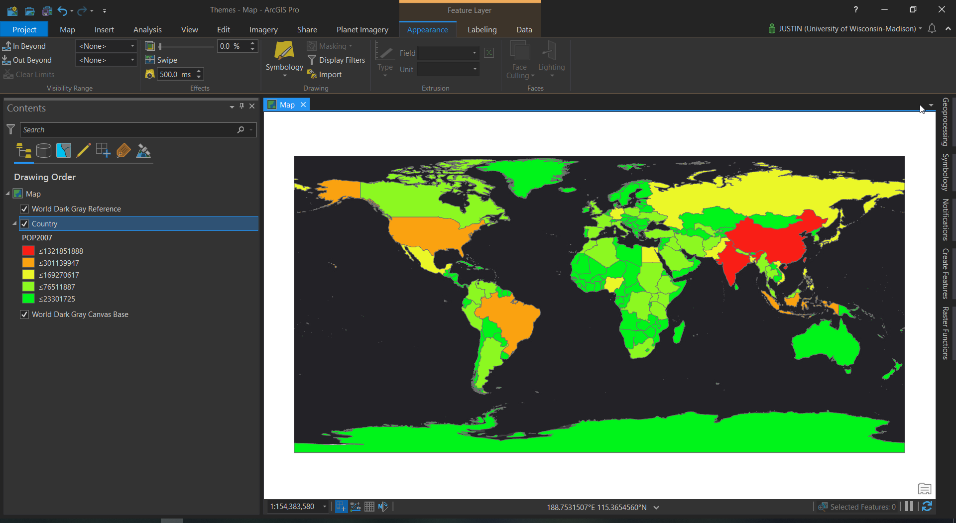
ArcGIS Pro Layout

Slide 13
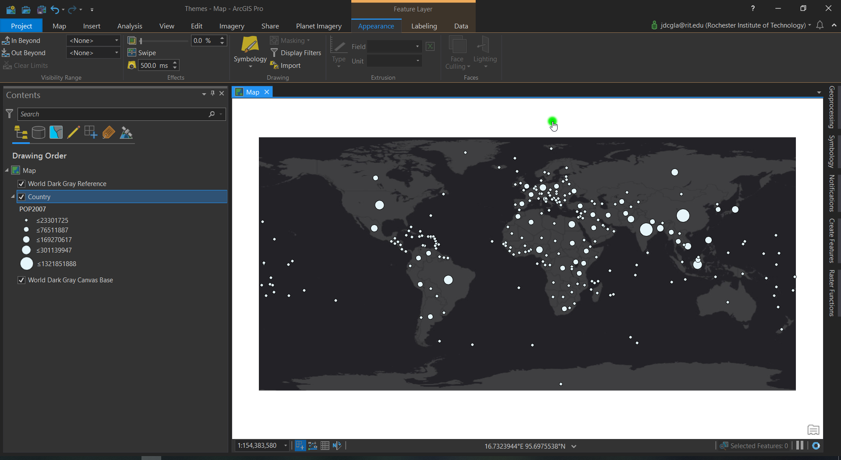
ArcGIS Pro Layout

Slide 14
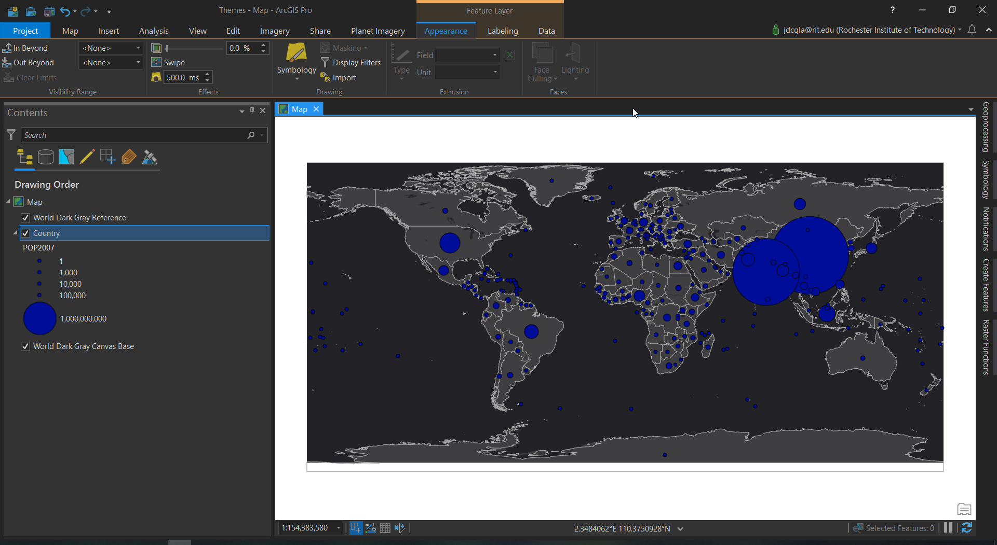
ArcGIS Pro Layout

Slide 15
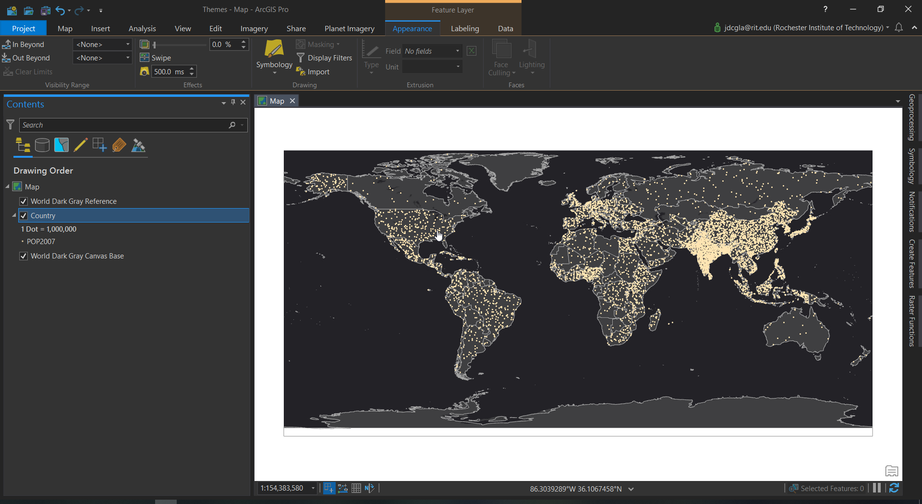
ArcGIS Pro Layout

Slide 16
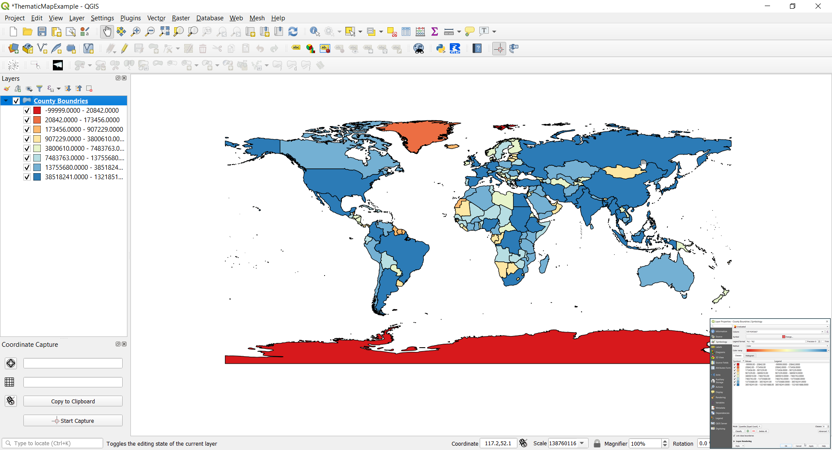
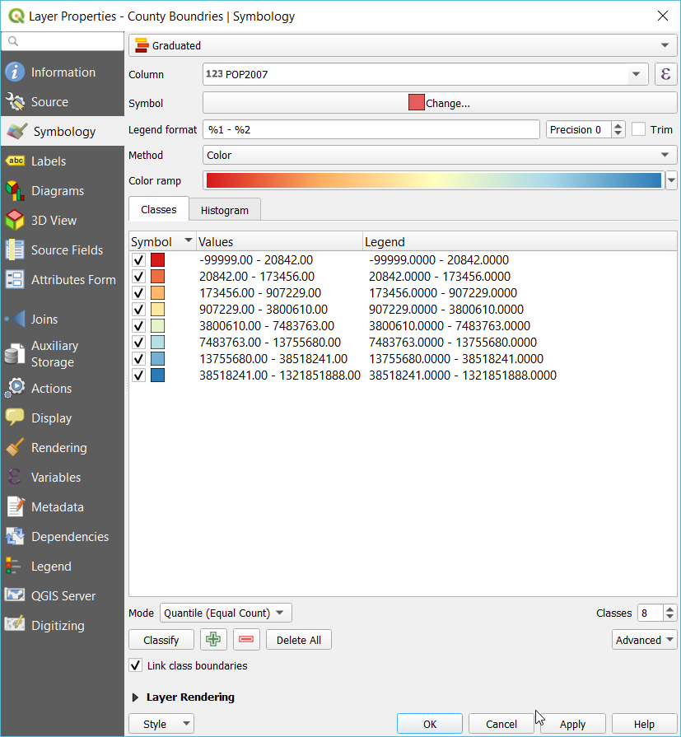
QGIS
In the Hands on Material Open ThematicMapExample.qgs

Slide 17
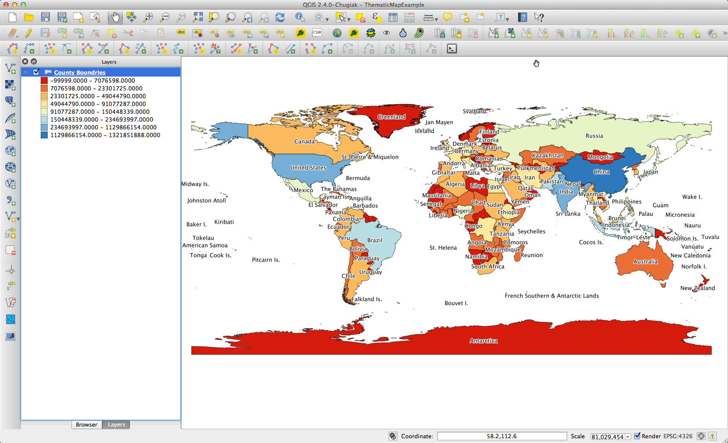
QGIS Layout
Opensource GIS

Slide 18
Hands On - Web Maps Examples
http://www.arcgis.com/home/webmap/viewer.html?webmap=34d9f29cbc514837b5979e08481ffcd3 John Snow Cholera Map
http://storymaps.esri.com/stories/2013/gettysburg/ Battle of Gettysburg
http://story.maps.arcgis.com/apps/StorytellingSwipe/index.html?appid=fba4350b6d4f4140966251b9c4d2f3a7&webmap=4b2b2784f68e4e5fb0c39c770f1b25ea San Francisco Eyeglass
http://www.arcgis.com/home/webscene/viewer.html?webscene=128ba9498cca447ab6ec356b84fee879 Airflow Globe
http://storymaps.esri.com/stories/2012/treasure-hunt-mountains/ Treasure Hunt
http://historicalmaps.arcgis.com/usgs/ Historic USGS Maps
https://storymaps.arcgis.com/stories/4fcddb805b0243988a42868f398a2ea0 - Innovative uses of story maps during the COVID-19 pandemic
https://storymaps.arcgis.com/stories/652993f26b064461a31e5befdb3d47f3 - DISCOVERY, INNOVATION & HOPE
https://storymaps.arcgis.com/stories/bce0eca488ab47a3b25f63ddca34e679 - The Cherry Blossoms of Washington, D.C.

Slide 19
Assignment
From the reading Lesson 21and22_1st Edition ArcGIS Book follow the 2 exercise learning about basemaps and map scales and resolutions.
When you have the exercise complete write a brief reflection on each of the different topics, paying extra attention to how basemaps can be used and what role scale and resolution may have in creating spatial products.

Slide 20
Reading for Next Week (9/7)
Longley et. al. c5 (2005)
Shelito (2012)
https://store.usgs.gov/product/16573
Fun - http://xkcd.com/977/
http://www.esri.com/news/arcnews/winter0809articles/the-geodatabase.html

